Slide 1


Seminar Large-scale Data Engineering (LDE)
01 Structure of Scientific Papers
Dr.-Ing. Patrick Damme
Technische Universität Berlin
Berlin Institute for the Foundations of Learning and Data
Big Data Engineering (DAMS Lab)
[Credit: Based on “Introduction to Scientific Writing”/
”01 Structure of Scientific Papers” by Matthias Boehm
(TU Graz, winter 2021/22)]
Last update: Oct 16, 2023

Slide 2

Announcements/Org
Hybrid Setting with Optional Attendance
  In-person in TEL 811 (~20 seats)
  Virtual via zoom
  https://tu-berlin.zoom.us/j/67376691490?pwd=NmlvWTM5VUVWRjU0UGI2bXhBVkxzQT09

Slide 3








About Me
Since 10/2022: Postdoc at TU Berlin, Germany
  FG Big Data Engineering (DAMS Lab) headed by Prof. Matthias Böhm
  Continuing work on integrated data analysis pipelines
  Research interests in the fields of database and ML systems
  (especially compiler & runtime techniques, extensibility)
2021-2022: Postdoc at TU Graz & Know-Center GmbH, Austria
  Data Management group headed by Prof. Matthias Böhm
  Started work on integrated data analysis pipelines
2015-2020: PhD student at TU Dresden, Germany
  Dresden Database Research Group headed by Prof. Wolfgang Lehner
  PhD thesis on making complex analytical database queries more efficient
  through lightweight compression of intermediate results
MorphStore
& TVL

Slide 4
FG Big Data Engineering (DAMS Lab) – Teaching
Architecture of
Database Systems
(ADBS, WiSe)
DB system internals
+ prog. project
Architecture of
ML Systems
(AMLS, SoSe)
ML system internals,
data science lifecycle
+ prog. project
Architecture of
ML Systems
(AMLS, SoSe)
SE Joint ML and DM (MLDM, SoSe+WiSe)
Master
Data Integration and Large-Scale Analysis
(DIA, WiSe)
SE/PR Large-scale Data Engineering
(LDE, SoSe+WiSe)
Data Integration and Large-Scale Analysis
(DIA, WiSe)
Distributed
Data Management
Bachelor
Intro to Scientific Methods (WiSe)
Data Management / Databases
(DM, SoSe+WiSe)
Data management from user/application perspective
PP Prog.-Practicals Data Systems
(PPDS, SoSe+WiSe)

Slide 5
Agenda
Course Organization, Outline, and Deliverables
Structure of Scientific Papers
List of Seminar Topics (Proposals)

Slide 6
Course Organization, Outline, and Deliverables

Slide 7
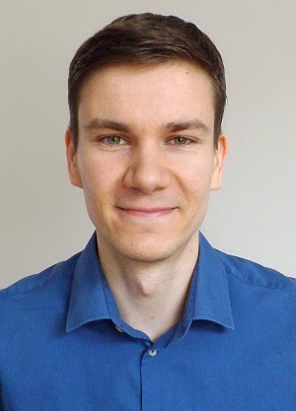
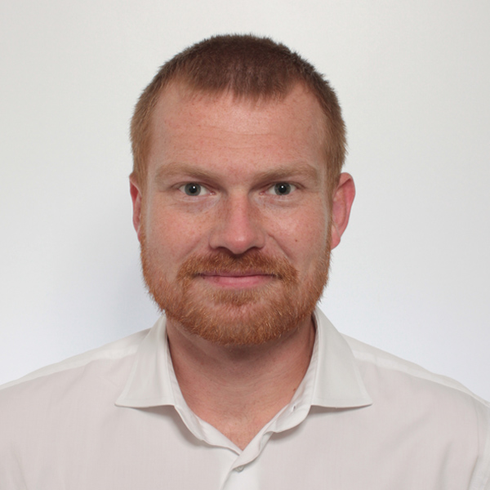
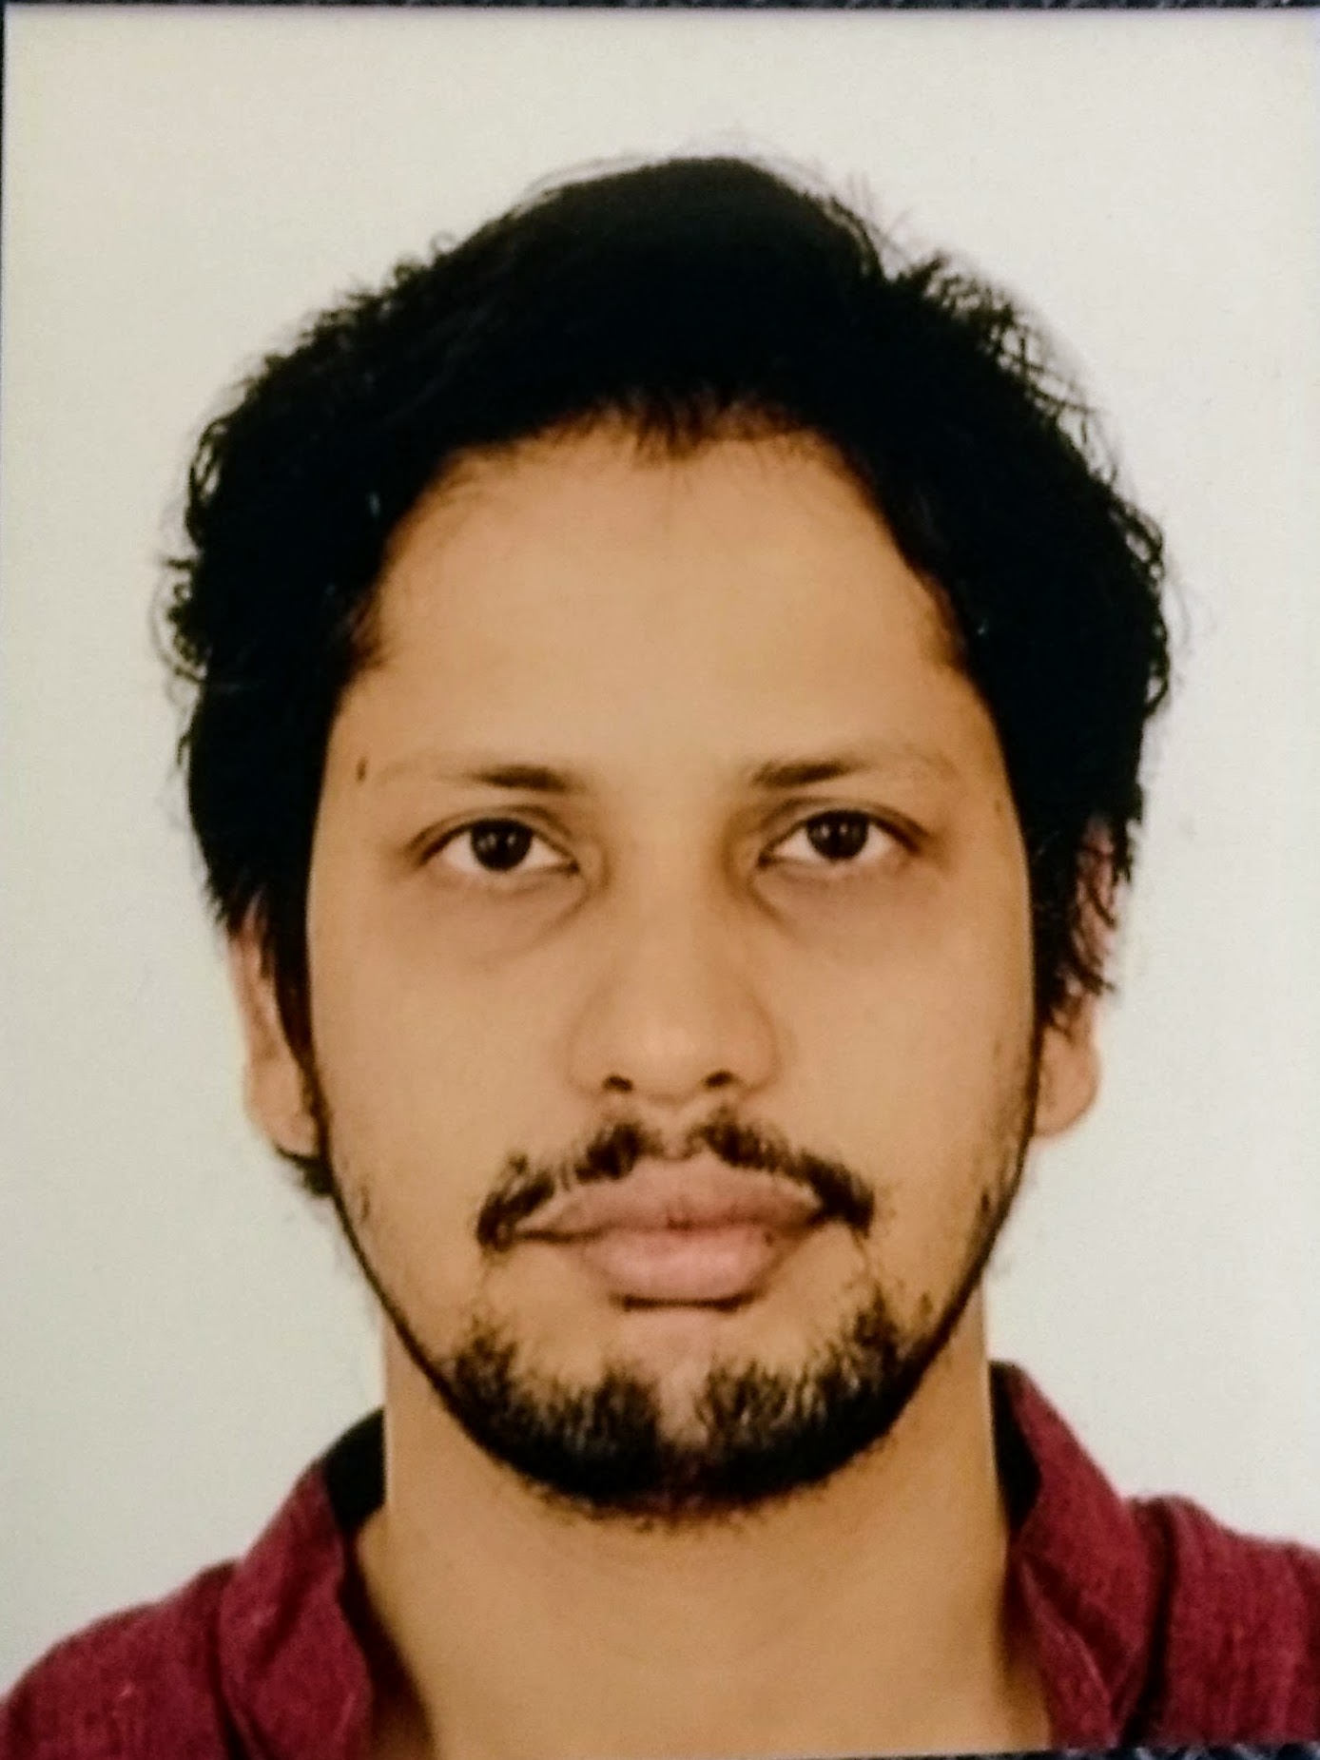

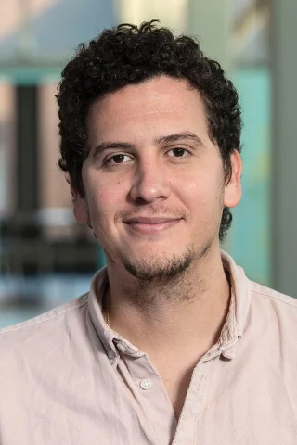
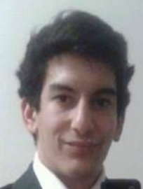
Large-scale Data Engineering: Module Overview
20+5 places in total
bachelor + master
#41086: LDE Seminar + Project (12 ECTS)
13 students
12 students
#41095: Seminar LDE (3)
#41094: Project LDE (9 ECTS)
6 students
bachelor-only
bachelor-only
Mon, 14:00-16:00
TEL 811 & zoom
Seminar LDE
Reading & writing scientific papers
Giving presentations on papers
Summary paper
Presentation
Lecturer & seminar mentor
Project LDE
Building & evaluating prototypes
Giving presentations on prototypes
Prototype design/impl/tests/doc
Presentation
Project mentors
Mon, 16:00-18:00
TEL 811 & zoom
In the context of systems for data engineering, data management, machine learning
In combination: Ideal preparation for a bachelor/master thesis with our group

Slide 8
Course Organization
General Contact Person
  Dr.-Ing. Patrick Damme (patrick.damme@tu-berlin.de)
Course Website
  https://pdamme.github.io/teaching/2023-24_winter/lde/lde_winter2023-24.html
  One site for seminar and project
  All material, schedule, deadlines
ISIS course
  https://isis.tu-berlin.de/course/view.php?id=35039
  Announcements, discussion forum, polls
Language
  Lectures and slides: English
  Communication: English/German
  Submitted paper and presentation: English
  Informal language (first name is fine), immediate feedback is welcome

Slide 9
Semester Schedule & Deadlines
Three Introductory Lectures (optional)
  Oct 16: Structure of Scientific Papers
  Oct 23: Scientific Reading and Writing
  Oct 30: Experiments, Reproducibility,
  and Giving Presentations
Self-organized Seminar Work
  Office hours for any questions (optional)
Final Presentations (mandatory)
  Jan 15: Session #1
  Jan 22: Session #2
  Jan 29: Session #3
  Feb 05: Session #4
  Feb 12: Session #5
List of Seminar Topics
  Presented today, take your time to select afterwards
Topic Selection
  Deadline: Oct 30, 23:59 CET (in 2 weeks)
  Ranked list of ~5 topics by email to Patrick Damme
  Global topic assignment based on preferences
  Notification of assigned topics: Nov 06 (in 3 weeks)
Submission of Summary Paper
  Deadline: Jan 08, 23:59 CET (in 12 weeks)
  Summary paper (PDF) by email to Patrick Damme
Submission of Presentation Slides
  Deadline: The day before you present, 23:59 CET
  Presentation slides (PDF) by email to Patrick Damme

Slide 10
Seminar Deliverables
Individual Seminar Work
  1 student = 1 paper, no team work
Summary Paper (in English)
  Read and understand selected paper
  Search for related work to provide some context
  Write summary paper (6 pages, excl. references)
  - including related work
  - make sure relation to umbrella topic is conveyed
  LaTeX with given template
Presentation
  Summarize your paper
  15 min talk + 5 min discussion (stay in time)
  Audience: engage in the discussion
Grading
  Graded portfolio exam
  #41086 (seminar + project)
    25 pts: summary paper
    15 pts: presentation
    50 pts: design/impl/tests/doc
    10 pts: presentation
  #41095 (seminar-only)
    65 pts: summary paper
    35 pts: presentation
Academic Honesty / No Plagiarism
(incl LLMs like ChatGPT)

Slide 11
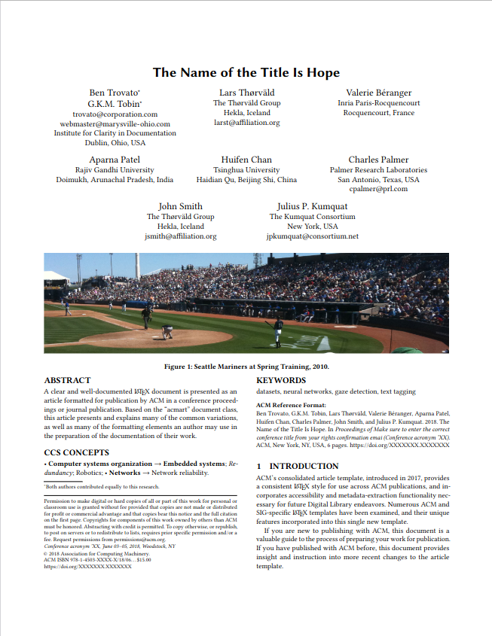
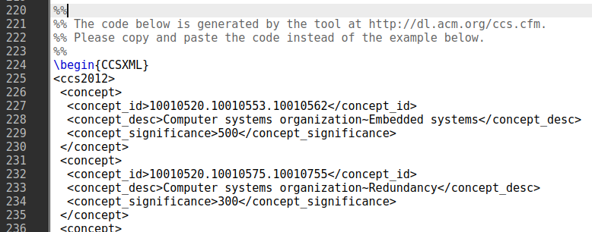
LaTeX Paper Template
ACM acmart template
document class sigconf (double-column)
https://www.acm.org/publications/
proceedings-template
CCS concepts
(ACM Computing Classification System)
Select concepts at http://dl.acm.org/ccs.cfm
and insert generated code:
Teaser image
Not required (especially no photograph)
Keywords
Specify meaningful keywords
ACM reference format
Just keep as it is (ignore the dummy data)
Copyright notice
Just keep as it is (ignore the dummy data)

Slide 12
Portfolio Exam Registration
Portfolio exam registration: Nov 06 – Dec 04
  Binding registration in Moses/MTS
  Including selection of seminar presentation date
  (first-come-first-serve)
Portfolio exam de-registration
  Until 3 days before the first graded exam part
    Modules “LDE”/”Seminar LDE”: until Jan 05
    Module “Project LDE”: until Feb 16
    De-register yourself in Moses/MTS
  With sufficient reason: Until the day of the exam
    In case of sickness etc.
    Modules “LDE”/”Seminar LDE”: until Jan 08
    Module “Project LDE”: until Feb 19
Missing deadlines/exam without de-registration
  Zero points in the respective exam part
  Approach us early in case of problems
If you don’t want to take LDE anymore
  Let me know asap to give students in the queue
  a chance to fill in

Slide 13
Structure of Scientific Papers
In Computer Science (Data Management)
[Credit: Based on “Introduction to Scientific Writing”/
”01 Structure of Scientific Papers” by Matthias Boehm
(TU Graz, winter 2021/22)]

Slide 14
Overview Types of Scientific Writing
Classification of Scientific/Technical Documents
  Formal vs informal writing, cumulative?, single vs multi-author, archival vs non-archival publications
Scientific Writing Skills are crucial
  Different types of docs share many similarities
/
Monographs
Scientific Papers
Others
BS Thesis
by pub. channel
by contents
Grant Proposal
Preprint
Research
MS Thesis
Design doc
Conference
Industry
PhD Thesis
White Paper
Journal
Survey
Habilitation
Blog
Tech Report
E&A
Website
Vision

Slide 15
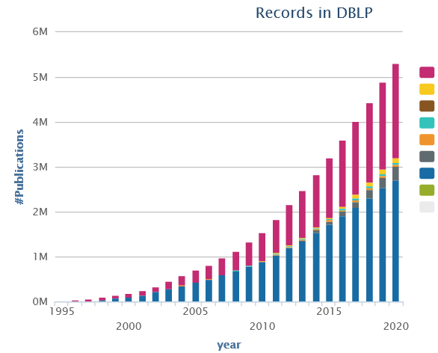
Preparation
Know your Audience
Get your Workflow in Order
  Writing: LaTeX (e.g., Overleaf, TeXnicCenter), versioning (e.g., git), templates
  Plotting: R (e.g., plot, ggplot), Python (e.g., matplotlib, seaborn), Gnuplot, LaTeX (e.g., pgfplots)
  Figures: e.g., MS Visio/MS Powerpoint, Inkscape → pdf, eps, svg (vector graphics)
Mindset: Quality over Quantity
  Aim for top-tier conferences/journals (act as filter)
  Make the paper useful for others (ideas, evidence, code)

Slide 16
Paper Writing and Publication Process
Research – Writing Cycle
  Read lots of papers
  Idea → Research → Writing → Document
  Idea → Writing/Research → Document
  Incremental refinement of drafts
Paper Submission Cycle
  Blind vs double-blind submission
  Revisions and Camera-ready
  Similar: bachelor/master thesis
  → drafts to advisor / final version
Example: SIGMOD 2024: Paper Submission Round 2
  April 15, 2023: Paper submission
  May 26 - 28, 2023: Author feedback phase
  June 20, 2023: Notification of accept/reject/review again
  July 20, 2023: Revised paper submission
  August 23, 2023: Final notification of accept/reject
  tba, 2023: Camera ready due
[Recommended Reading]
[Eamonn Keogh: How to do good research, get it published in SIGKDD and get it cited!, KDD 2009]
[Simon Peyton Jones: How to write a great research paper, MSR Cambridge]

Slide 17
Running Example
Example paper used in the following
  Ahmed Elgohary, Matthias Boehm, Peter J. Haas, Frederick R. Reiss, Berthold Reinwald: Compressed Linear Algebra for Large-Scale Machine Learning. PVLDB 2016
[Ahmed Elgohary, Matthias Boehm, Peter J. Haas, Frederick R. Reiss, Berthold Reinwald: Scaling Machine Learning via Compressed Linear Algebra. SIGMOD Record 2017 46(1)]
[Ahmed Elgohary, Matthias Boehm, Peter J. Haas, Frederick R. Reiss, Berthold Reinwald: Compressed Linear Algebra for Large-Scale Machine Learning. VLDB Journal 2018 27(5)]
[Ahmed Elgohary, Matthias Boehm, Peter J. Haas, Frederick R. Reiss, Berthold Reinwald: Compressed Linear Algebra for Large-Scale Machine Learning. Commun. ACM 2019 62(5)]

Slide 18
Ideas and Topic Selection
Problem-Oriented Research
  Focus on problem/observation first, not your solution
  Discuss early ideas with collaborators and friends
  Develop your taste for good research topics
  Topic selection needs time → pipeline model
Ex. Compressed Linear Algebra
  Problem: Iterative ML algorithms + memory-bandwidth-bound operations
  → crucial to fit data in memory → automatic lossless compression
  Sub-problems: #rows>>#cols, column correlation, column characteristics
  → column-wise compression w/ heterogeneous encoding formats
Progress
Time

Slide 19
Prototypes and Experiments
Worst Mistake: Schrödinger's Results
  Postpone implementation and experiments till last before the deadline
  No feedback, no reaction time (experiments require many iterations)
  Karl Popper: falsifiability of scientific results
Continuous Experiments
  Run experiments during survey / prototype building
  Systematic experiments → observations and ideas for improvements
  Don’t be afraid of throwíng away prototypes that don’t work
Ex. Compressed Linear Algebra
  Data characteristics inspired overall design of encoding schemes
  Initially slow compression → dedicated sampling schemes and estimators
  Initially slow compressed operations → cache-conscious operations,
  selected operations with better asymptotic behavior

Slide 20
Prototypical Structure of a Scientific Paper
Title & Authors
Sections and Subsections
  Abstract → short overview of problem and solution (part of meta data)
  Introduction → context, problem, contributions
  Background / Preliminaries → necessary background for understanding
  Main Part → your technical core contributions
  Main Part 2
  Experiments → setting, micro benchmarks, end-to-end benchmarks
  Related Work → areas of related work, differences to your own work
  Conclusions → summary, conclusions, and future work
  Acknowledgments → funding agencies, helpful people beyond co-authors
  References → list of other works referenced throughout the paper
  (Appendix) → any additional contents (e.g., proves of theorems, more results)

Slide 21

Title and Authors
List of Authors
  E.g., by contribution (main, …, advisor)
  E.g., by last name
  Affiliations, contact (corresponding author)
Title
  Descriptive yet concise
  Short name if possible → easier to cite and discuss
[Credit: sliceline,
Silicon Valley, HBO]

Slide 22
Abstract
% 1. State the problem
Large-scale machine learning (ML) algorithms are often iterative, using repeated read-only data access and I/O-bound matrix-vector multiplications to converge to an optimal model. It is crucial for performance to fit the data into single-node or distributed main memory.
% 2. Say why it's an interesting problem
General-purpose, heavy- and lightweight compression techniques struggle to achieve both good compression ratios and fast decompression speed to enable block-wise uncompressed operations.
% 3. Say what your solution achieves
Hence, we initiate work on compressed linear algebra (CLA), in which lightweight database compression techniques are applied to matrices and then linear algebra operations such as matrix-vector multiplication are executed directly on the compressed representations. We contribute effective column compression schemes, cache-conscious operations, and an efficient sampling-based compression algorithm. Our experiments show that CLA achieves in-memory operations performance close to the uncompressed case and good compression ratios that allow us to fit larger datasets into available memory.
% 4. Say what follows from your solution
We thereby obtain significant end-to-end performance improvements up to 26x or reduced memory requirements.
[Simon Peyton Jones: How to write a great research paper, MSR Cambridge]

Slide 23
Introduction
Prototypical Structure
  Context (1 paragraph)
  Problems (1-3 paragraphs)
  [Existing Work (1 paragraph)]
  [Idea (1 paragraph)]
  Contributions (1 paragraph)
Introduction Matters
  Anchoring: most reviewers reach their opinion after reading introduction and motivation and then look for evidence
[Eamonn Keogh: How to do good research, get it published in SIGKDD and get it cited!, KDD 2009]

Slide 24
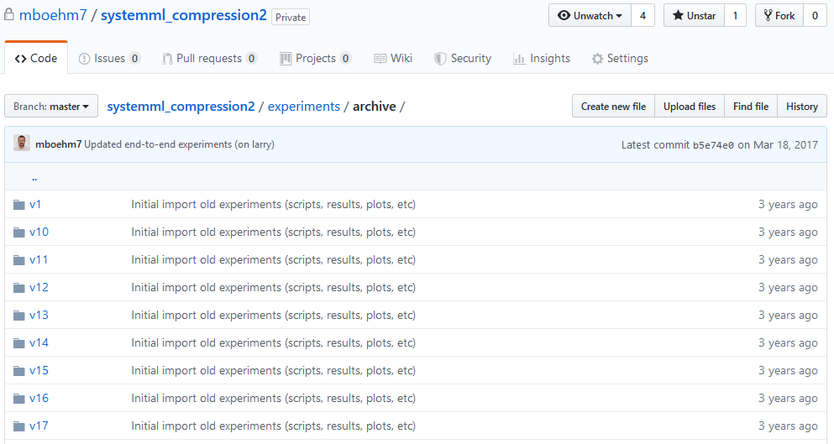
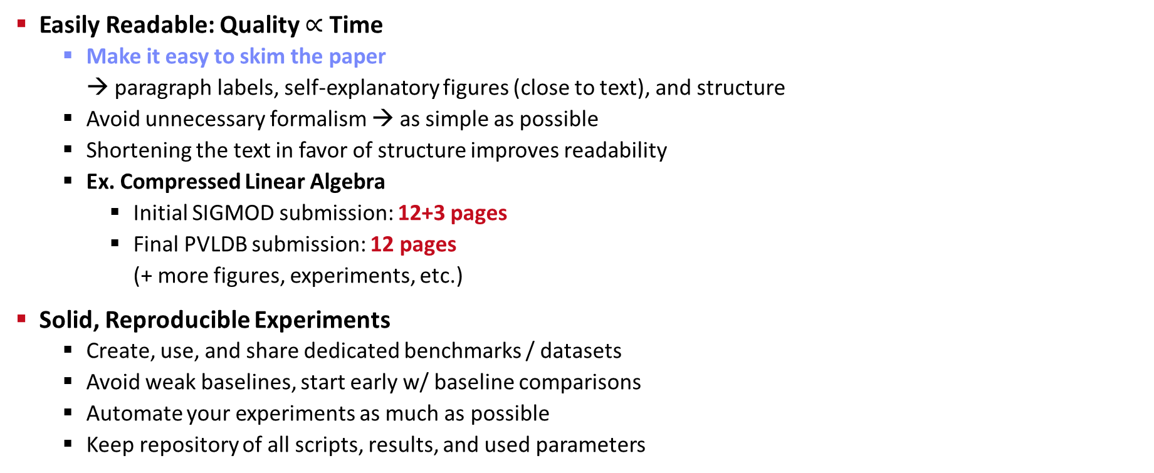
Writing the Paper (and more Experiments)
Easily Readable: Quality $∝$ Time
  Make it easy to skim the paper
  → paragraph labels, self-explanatory figures (close to text), and structure
  Avoid unnecessary formalism → as simple as possible
  Shortening the text in favor of structure improves readability
  Ex. Compressed Linear Algebra
    Initial SIGMOD submission: 12+3 pages
    Final PVLDB submission: 12 pages
    (+ more figures, experiments, etc.)
Solid, Reproducible Experiments
  Create, use, and share dedicated benchmarks / datasets
  Avoid weak baselines, start early w/ baseline comparisons
  Automate your experiments as much as possible
  Keep repository of all scripts, results, and used parameters
02 Scientific Reading and Writing
03 Experiments, Reproducibility, and
Giving Presentations
https://github.com/damslab/
reproducibility

Slide 25
Related Work
Purpose of a “Related Work”-Section
  Not a mandatory task or to show you know the field
  Put you work in context of related areas (~ 1 paragraph each)
  Discuss closely related work
  Crisp separation from existing work (what are the differences)
Placement
  Section 2 or Section n-1
  Throughout the paper
Give Credit
  Cite broadly, give credit to inspiring ideas, create connections
  Honestly acknowledge limitations of your approach
[Simon Peyton Jones: How to write a great research paper, MSR Cambridge]

Slide 26
References
Setup
  Use LaTeX \cite{} and BibTeX
  Use a consistent source of bibtex entries (e.g., DBLP)
Different References Styles
  But, not in footnotes (unless required)
inproceedings{StonebrakerBPR11,
author = {Michael {Stonebraker et al.}},
title = {{The Architecture of SciDB}},
booktitle = {{SSDBM}},
year = {2011}
}
\bibliographystyle{abbrv}
\bibliography{VLDB2016}
VLDB2016.bib

Slide 27
Dealing with Feedback / Criticism
Different Kinds of Feedback
  Casual discussion of early ideas
  Comments on paper drafts
  Reviewer comments (good and bad)
Example Compressed Linear Algebra
  SIGMOD Reviewer 2 (REJECT)
    “The rewriting for q=Xv seems wrong: To compute q, one takes
    each row of the matrix X and multiplies it with the vector v.”
  PVLDB Reviewer 3 (WEAK ACCEPT)
    “I kinda disagree with the broad definition of declarative ML […].”
Paper Rebuttal and/or Revision
  Rebuttal: seriously consider all feedback (in doubt agree), and
  answer with facts / ideas how to address the comments
  Revision (conditional accept): address all revision requests
Always welcome feedback/criticism
Address all feedback w/ sincere effort
[Matthias Boehm et al.: Declarative Machine Learning - A Classification of
Basic Properties and Types. CoRR 2016.]

Slide 28
List of Seminar Topics (Proposals)
See list at https://pdamme.github.io/teaching/2023-24_winter/lde/SeminarTopics.pdf

Slide 29
Summary and Q&A
Course Organization, Outline, and Deliverables
Structure of Scientific Papers
List of Seminar Topics (Proposals)
Remaining Questions?
Next Lectures
  02 Scientific Reading and Writing [Oct 23]
  03 Experiments, Reproducibility, and Giving Presentations [Oct 30]

