Slide 1
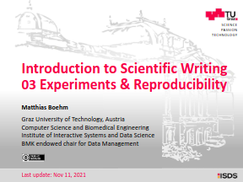

Seminar Large-scale Data Engineering (LDE)
03 Experiments, Reproducibility & Presentations
Dr.-Ing. Patrick Damme
Technische Universität Berlin
Berlin Institute for the Foundations of Learning and Data
Big Data Engineering (DAMS Lab)
[Credit: Based on “Introduction to Scientific Writing”/
”03 Experiments and Reproducibility” by Matthias Boehm
(TU Graz, winter 2021/22)]
Last update: Oct 23, 2026

Slide 2

Announcements/Org
Hybrid Purely Virtual Setting with Optional Attendance
  In-person in MAR 0.015
  Virtual via zoom
  https://tu-berlin.zoom-x.de/j/67376691490?pwd=NmlvWTM5VUVWRjU0UGI2bXhBVkxzQT09
Completed Seminar and Project Topic Selection
  Seminar: Announcement of topic assignment by today
  Project: Announcement of topic assignment in one week

Slide 3
Agenda
Experiments and Result Presentation
Reproducibility and RDM
Scientific Presentations

Slide 4
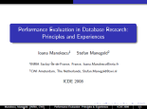
Experiments and Result Presentation
In Computer Science (Data Management)
[Credit: Ioana Manolescu, Stefan Manegold: Performance Evaluation in Database Research: Principles and Experiences, ICDE 2008]

Slide 5
Motivation
Worst Mistake: Schrödinger's Results
  Postpone implementation and experiments till last before the deadline
  No feedback, no reaction time (experiments require many iterations)
Continuous Experiments
  Run experiments during survey / prototype building
  Systematic experiments → observations and ideas for improvements
  Don’t be afraid of throwing away prototypes that don’t work
Good Research Fires Itself
  Initial experiments give directions for further improvements
  Problem-oriented methodology

Slide 6
Types of Experiments
#1 Exploratory Experiments
  Tests for functional correctness
  Unstructured experiments for initial feedback → evaluate feasibility
#2 Micro Benchmarks
  Measure specific aspects in controlled and understandable scope
  Bottom-up approach
#3 Benchmarks
  Evaluate on community/your own benchmarks
  Examples: TPC-C, TPC-H, TPC-DS, JOB, MLPerf, TPCx-AI
#4 End-to-end Applications
  Evaluate in larger scope of real datasets and query workloads
  Examples: Customer workload, ML pipelines (data preparation, training, evaluation)

Slide 7
[I. Manolescu, S. Manegold: Performance Evaluation in Database Research:
Principles and Experiences, ICDE 2008]
From Idea to Experiments
Overview
  Proper planning helps to keep you from “getting lost”
  Repeatable experiments simplify your own work
  There is no single way how to do it right
  There are many ways how to do it wrong
Basic Planning
  Which data / datasets should be used?
  Which workload / queries should be run?
  Which baselines are relevant?
  Which hardware & software should be used?
  Metrics: What to measure? How to measure?
  Comparison: How to compare? How to find out what is going on?

Slide 8
Dataset Selection
Synthetic Data
  Generate data with specific data characteristics
  Benchmarks with data generators (inspired by real-world use cases)
  Systematic evaluation with data size, sparsity, distributions etc.
  Don’t use too small data sizes (should the data (not) fit into CPU cache,
  main memory, single-node storage, cluster, etc.?)
“Real” Data Repositories
  Wide selection of available datasets with different characteristics
  UCI ML Repository: https://archive.ics.uci.edu/
  SuiteSparse Matrix Collection: https://sparse.tamu.edu/
  Google dataset search: https://datasetsearch.research.google.com/
  Common Datasets in ML: ImageNet, Mnist, CIFAR, KDD, Criteo
  Common Datasets in DM: Census, Taxi, Airlines, DBLP, benchmarks etc.
Representative
of real data distributions?
Representative for variety of workloads / common case?

Slide 9
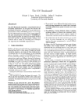
Workloads: Benchmarks
Overview
  Remember: Types of experiments: (exploratory experiments),
  micro benchmarks, benchmarks, end-to-end applications
Benchmarks
  Community- and organization-driven creation of agreed benchmarks
  Benchmarks can define a field and foster innovation
  #1 Data Management
    Query processing: 007, TPC-C, TPC-E, TPC-H, TPC-DS (w/ audit), SSB
    Join ordering: JOB
  #2 “Big Data”
    MapReduce/Spark: BigBench, HiBench, SparkBench
    Array Databases: GenBase
  #3 Machine Learning Systems
    SLAB, DAWNBench, MLPerf, MLBench, AutoML Bench,
    Meta Worlds, TPCx-AI
[Michael J. Carey, David J. DeWitt, Jeffrey F. Naughton: The oo7 Benchmark. SIGMOD 1993]
[https://www.tpc.org/tpch/]
(See AMLS course for details)

Slide 10
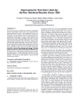
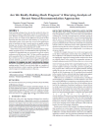
Baselines
#1 Primary Baseline
  Existing algorithm or system infrastructure
  Main comparison point, usually with same runtime operations
  Beware: Avoid speedup-only results
  (need absolute numbers for grounding)
#2 Additional Baselines
  Alternative systems with different runtime and compiler
  Usually, not directly comparable but important for grounding
  E.g., SystemDS: R, Julia, Spark, TensorFlow, PyTorch, …
  E.g., DAPHNE: the same, plus numpy, pandas, DuckDB, …
  Potential hindering factors: commercial and
  closed-source systems, software licenses
Problem of Weak Baselines
  Authors want to show improvements
  Successive improvements over
  state-of-the-art don’t add up
[Timothy G. Armstrong, Alistair Moffat, William Webber, Justin Zobel: Improvements That Don't Add Up: Ad-Hoc Retrieval Results Since 1998. CIKM 2009]
[Maurizio Ferrari Dacrema, Paolo Cremonesi, Dietmar Jannach: Are We Really Making Much Progress? A Worrying Analysis of Recent Neural Recommendation Approaches. RecSys 2019]

Slide 11
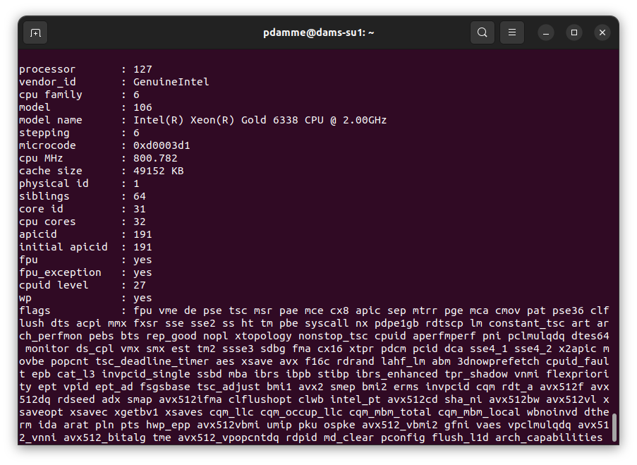
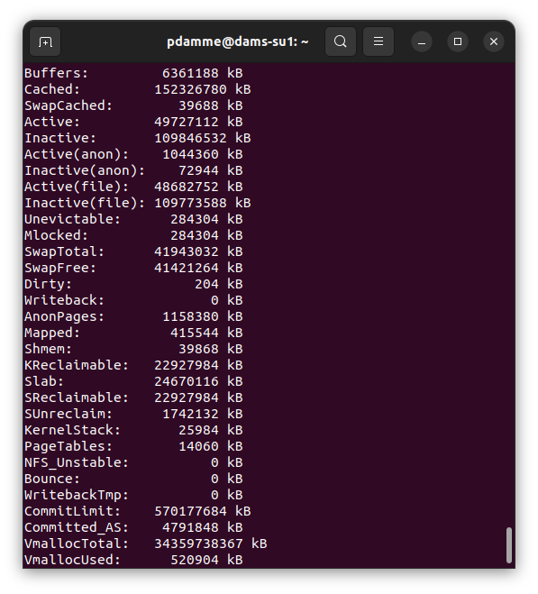
Experimental Setting (Hardware & Software)
Hardware Selection
  Multiple nodes for distributed computation
  Avoid too outdated hardware (irrelevance)
Find Balanced Level of Detail
  Underspecified:
  “We ran all experiments on an Intel CPU”
  Over-specified:
  cat /proc/cpuinfo
  cat /proc/meminfo
Recommendation
  HW components: #nodes, CPUs (#cores, clock freq., cache size), memory, network, I/O
  SW components: OS, programming language, versions, other software, compiler flags
  Baselines and configuration → Use recent versions of baseline systems
  Data and workloads with data sizes, parameters, configurations

Slide 12
Metrics & Comparison
Typical Metrics
  Runtime (elapsed time) [e.g., ms]
  Throughput [e.g., GB/s]
  Memory/storage consumption [e.g., GB]
  Performance counters [e.g., #L1d-cache misses]
  Result quality, e.g.
  accuracy, recall/precision, various error metrics
  Useful metrics depend on goal of experiment
How to Measure
  General tools: e.g., time, perf, top, htop, iotop
  System-spefic tracing/statistics tools, e.g.
    DAPHNE: --timing, --statistics
    SystemDS: -stats <count>
Repeat Measurements & Calculate Mean/Median
  Reduce sensitivity to outliers
Ensure Fair Comparison
  Use recent version of all baselines
  Use the right compiler and prog language flags
  (e.g., optimization levels: g++ -O3)
  Tune baselines by hand to get the most out of them
  See their docs for the args, config and tuning knobs
Result Interpretation
  Don’t just report the results
  Try to understand and explain them

Slide 13
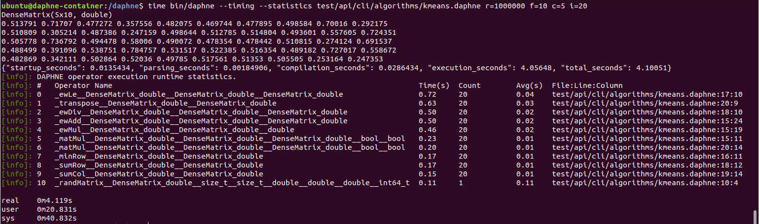
Metrics & Comparison: Measuring Time in DAPHNE
Example: k-Means Clustering on Small Random Dataset in DAPHNE
script
output
--timing
--statistics
time

Slide 14


Presentation – Figures
Axes
  Use informative axes labels with units (e.g., Total Execution Time [ms])
  Don’t cheat or mislead readers and reviewers
  Start y-axis at 0 for linear scale
100
Yours
100
Yours
Runtime
90
Mine
Runtime [s]
Runtime [s]
50
80
Mine
Aha, so 12%
0
1
2
3
What are the units? Where are the ticks?
Misleading y axis

Slide 15
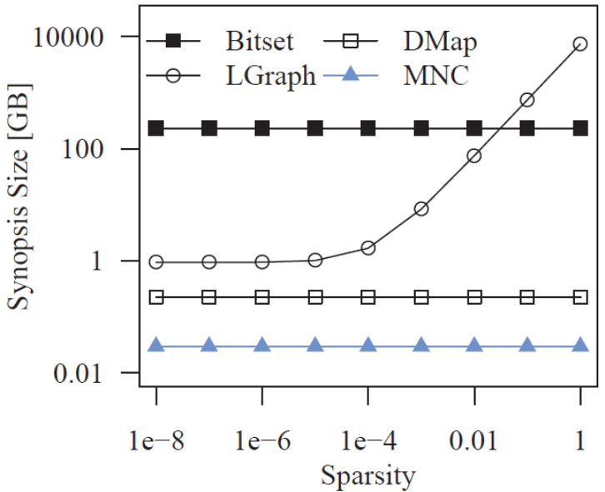
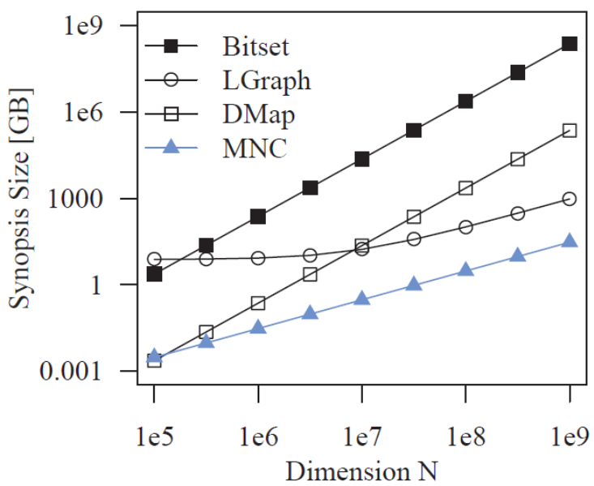
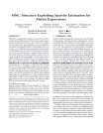
Presentation – Figures, cont.
Fair Ranges of Parameters
  Evaluate common ranges of values
  Don’t hide important information
[J. Sommer, M. Boehm, A. V. Evfimievski,
B. Reinwald, P. J. Haas: MNC: Structure-Exploiting Sparsity Estimation for
Matrix Expressions. SIGMOD 2019]
If there are multiple relevant parameters, show them all
For log-scale you can’t start at 0
Don’t limit range to make you look good

Slide 16
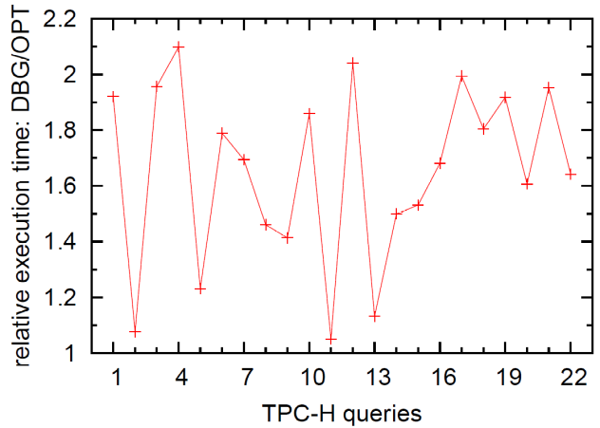
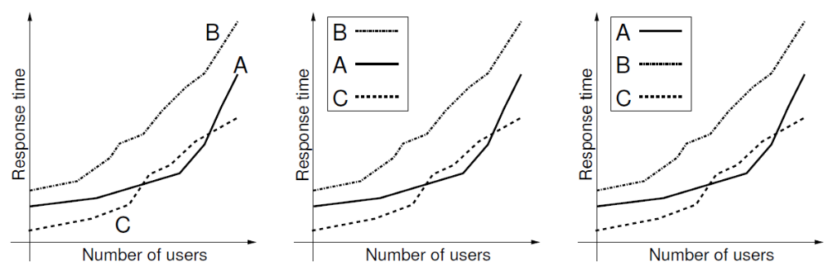
[I. Manolescu, S. Manegold: Performance Evaluation in Database Research:
Principles and Experiences, ICDE 2008]
Presentation – Figures, cont.
Plots Types
  Barplot for categories
  Plot + Line/linepoints for
  continuous parameters
  Visible font sizes (similar to text)
Legends
  Order them by appearance
  Attach directly to graph
Categorical x-axis.
What do lines mean?
Human brain is a
poor join processor
Humans get frustrated

Slide 17
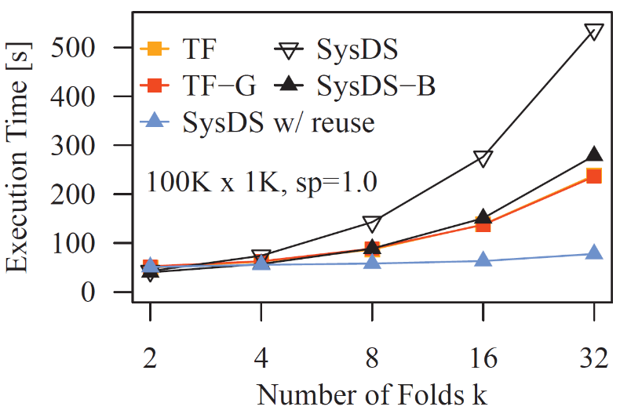
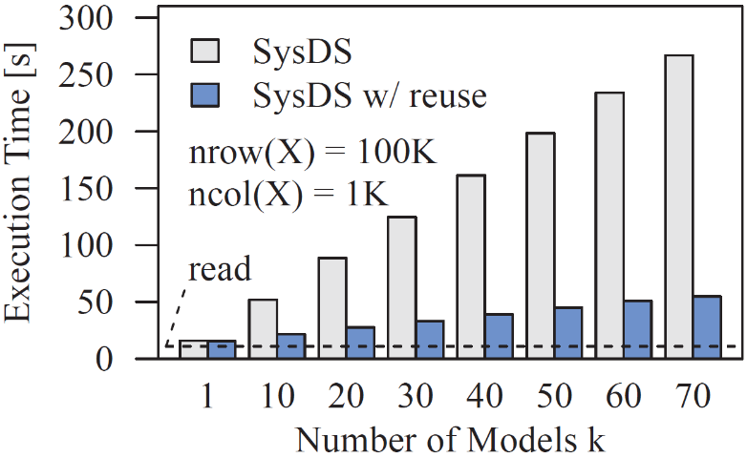
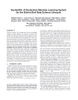
Presentation – Figures, cont.
Diversity & Consistency
  Diversity: if applicable use mix of different plot types and tables
  Consistency: use consistent colors and names for same baselines
Labeling
  Make the plots self-contained
  Simplifies skimming and avoids join with text
[Matthias Boehm et al: SystemDS: A Declarative Machine Learning System for the End-to-End Data Science Lifecycle. CIDR 2020]

Slide 18
Reproducibility and
RDM (Research Data Management)
In Computer Science (Data Management)

Slide 19
Research Data Management (RDM)
Overview
  Ensure reproducibility of research results and conclusions
  Common problem: “All code and data was on the student’s laptop
  and the student left / the laptop crashed.”
  Create value for others (compare, reuse, understand, extend)
  EU Projects: Mandatory proposal section & deliverable on RDM plan

Slide 20

Excursus: FAIR Data Principles
[https://www.go-fair.org/fair-principles/]
Findable
  Metadata and data have globally unique persistent identifiers
  Data described with rich meta data; registered/indexed and searchable
Accessible
  Metadata and data retrievable via open, free and universal comm protocols
  Metadata accessible even when data no longer available
Interoperable
  Metadata and data use a formal, accessible, and broadly applicable format
  Metadata and data use FAIR vocabularies and qualified references
Reusable
  Metadata and data described with plurality of accurate and relevant attributes
  Clear license, associated with provenance, meets community standards

Slide 21
RDM in Practice @ DAMS Lab
Code and Artifacts
  Open-source systems
    Apache SystemDS: https://github.com/apache/systemds
    DAPHNE: https://github.com/daphne-eu/daphne
    Complete code history, src/bin releases
    LDE/AMLS/DIA programming projects in SystemDS and DAPHNE
  Additional private GitHub repos for student projects / prototypes
  Reproducibility for publications: https://github.com/damslab/reproducibility
Central Paper Repository
  All paper submissions with LaTeX sources, figures, reviews, rebuttals, etc.
  All paper-related experiments
    Archive: append-only experimental results
    Plots: scripts and figures of plots
    Results: latest results used for the current plots
    Scripts: data preparation, baselines, benchmarks
Automate your experiments
as much as possible

Slide 22

SIGMOD Reproducibility Process
[Credit: https://reproducibility.sigmod.org/]
Overview
  Accepted papers can submit package, verified by committee
  “Artifacts Available”, “Artifacts Evaluated – Reusable”, “Results Replicated” badges
  Best Artifact Award ($750, visibility)
#1 Artifact Availability and Evaluation (aka Repeatability)
  Expected: Prototype system, input data(gen), experiments, diagram creation
  Ideally: Exceed minimal functionality, clear docs, facilitate reuse
#2 Reproducibility
  Central results and claims supported by the submitted experiments
  Expected: similar behavior to that shown in the paper

Slide 23
SIGMOD Reproducibility Process, cont.
[Credit: https://reproducibility.sigmod.org/]
Ideal Reproducibility Submission
  “At a minimum the authors should provide a complete set of scripts to install the system, produce the data, run experiments and produce the resulting graphs along with a detailed Readme file that describes the process step by step so it can be easily reproduced by a reviewer.
  The ideal reproducibility submission consists of a master [sic] script that:
    installs all systems needed,
    generates or fetches all needed input data,
    reruns all experiments and generates all results,
    generates all graphs and plots, and finally,
    recompiles the sources of the paper
  ... to produce a new PDF for the paper that contains the new graphs. “
Note: It takes time, plan from start

Slide 24
Scientific Presentations
In Computer Science (Data Management)

Slide 25
Goals and Structure
Typical Goals of a Scientific Presentation
  Make audience aware of and interested in your work → visibility, get your paper cited
  Show that you made significant contributions to relevant research area
  Discuss problem/topic, get feedback from audience, foundation for offline discussion
Structure
  No single best structure, but best practices
  Commonalities with scientific papers
    Introduction/motivation (including necessary background)
    Main part (your own contributions)
    Experimental results
    Summary & outlook

Slide 26
Limit the Scope
Typical Duration
  Lecture: ~90-120 min
  Thesis defense: ~45 min
  Seminar talk: ~20 min
  Conference talk ~5-15 min
Limit the Scope, You Cannot Talk about Everything
  In terms of breadth
    E.g., focus on a subset of the contributions
    E.g., not all experiments
    But: give overview of everything
  In terms of depth
    I.e., don’t show all details
    Present simplified results
Challenge: Usually not to fill the time,
but to not go over time
Challenge: Select the most important aspects

Slide 27
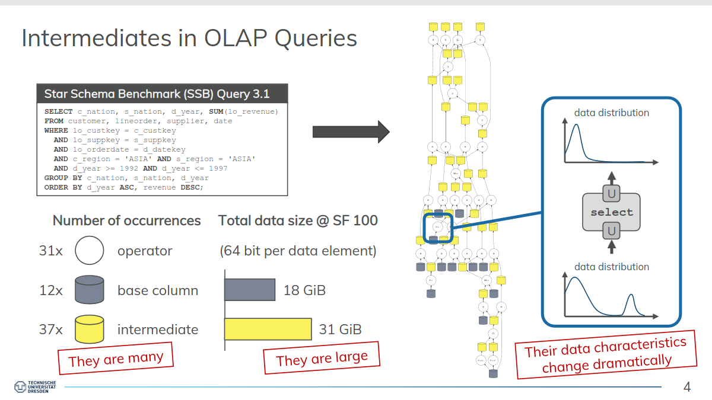
Know Your Audience
Audience Characteristics
  How much can you expect them to know about your topic? Don’t assume too much…
  Need to adjust to you as a speaker in the beginning
Help Audience Not to Get Lost
  Clear motivation (don’t rush through it)
  Clear presentation outline
  (after motivation, otherwise hard to comprehend)
  Outline and current position again
  after each section of the talk
  Repeat important assumptions
  Illustrate theory with concrete (running) examples
  Take necessary time for complex diagrams, formulas, etc.
Steer Audience’s Attention
  Make the most important points pop out
  (Simple) animations
    Reveal complex slide contents incrementally
    But: avoid “Powerpoint Poisoning”
“If you remember one thing
from this presentation,
it should be that ...”

Slide 28
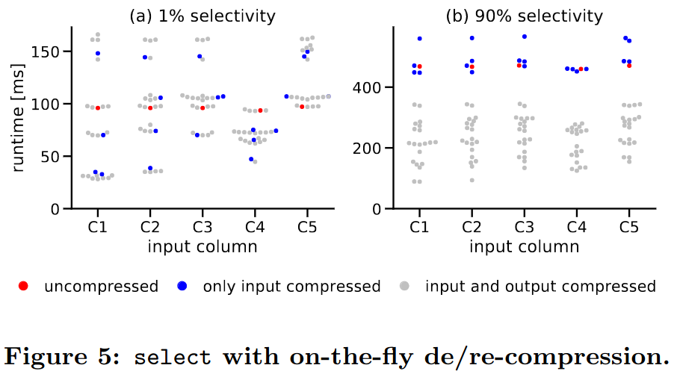
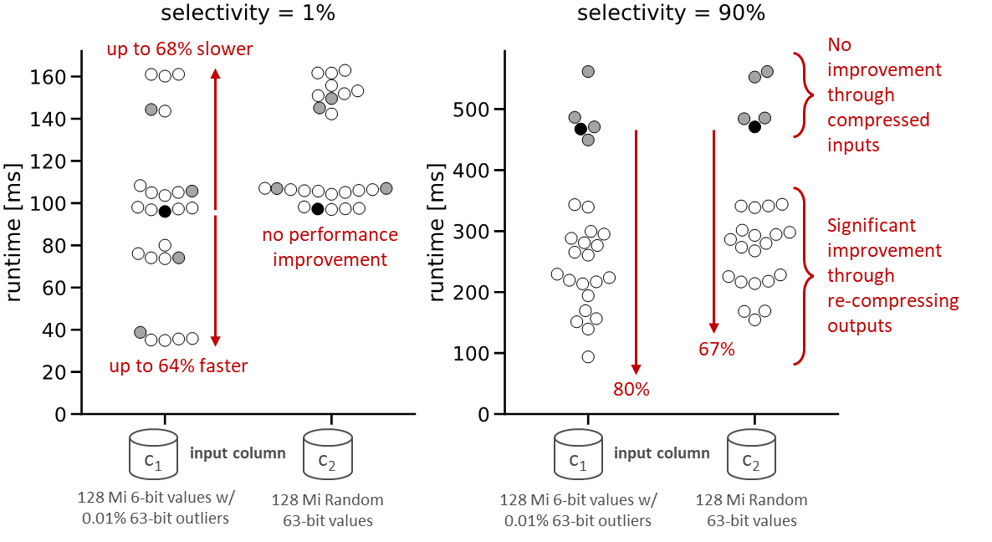
Slide Design
Avoid Slides Full of Text
Avoid Complex Formulas and Source Code
  Unless they really contribute to the understanding
Avoid too Small Font Size
Avoid too Many Effects
Use Varied Layouts
  Not just lists of bullet points
  Convey information in diagrams, figures, etc.
Use Simple Set of Colors
Use Conscious Line Breaks
Don’t Simply Reuse the Figures from Your Paper
paper
slides

Slide 29
Preparing a Presentation
#1 Planning
  Who’s your audience?
  What are the key takeaways you want to convey?
  Structure of the talk, running examples
#2 Slide Creation
  Create initial slide deck (doesn’t need to be pixel-perfect yet)
  Should contain all planned content, consciously divided into slides
#3 Practice
  Rehearse aloud, ideally with audience (ask for max constructive criticism)
  Does the timing fit? Is the talk comprehensible?
#4 Slide Finalization
  Make the slides pixel-perfect
Iterate steps
if necessary

Slide 30
Handling Questions
Basic Mindset
  Always welcome questions as well as feedback/criticism
  Take all questions constructively
You Don’t Need to Always Have an Answer
  Answer as good as you can
  Honestly admit if you don’t know the answer, e.g., if it needs further investigation
Take longer discussions offline
  Don’t bore the rest of the audience with too specific discussions
Page Numbers on Slides
  Help audience to refer to specific point in your presentation
Prepare Back-up Slides
  Extra slides not shown in the main presentation
  Can be useful when answering questions

Slide 31
Summary and Q&A
Experiments and Result Presentation
Reproducibility and RDM
Scientific Presentations
Remaining Questions?
Self-organized Seminar/Project Work and Optional Consultation Hours:
  Seminar: Mondays 14:00 – 16:00 hybrid in FR 768 and zoom
  Project: Arrange individual meetings with project mentor
Seminar/Project Submission Deadlines & Presentation Dates on Course Website

